Slide 1
Evaluating Information
Genome 575: Fundamentals of Biomedical Instrumentation
Brian Beliveau

Slide 2
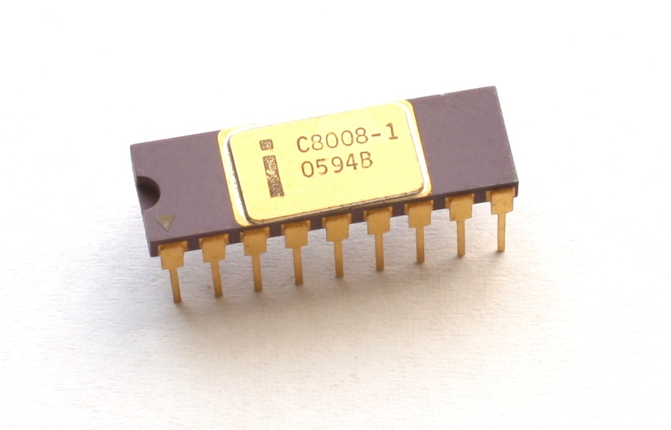
Open questions from last week (2023) 1
Why does FM sound better?
Why 8 bits for byte? Related to dynamic range of the eye?
Amplitude fluctuates, causes static if part of code (AM). Not part of code with frequency (FM)
Intel C8008-1, 1972
https://upload.wikimedia.org/wikipedia/commons/b/ba/KL_Intel_C8008-1.jpg

Slide 3
Recap from last time
Information can be discrete or continuous
Sampling rate is a very important consideration
Information can be quantized (bits)
Information entropy describes the “expected surprisal”

Slide 4
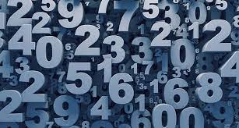
The guessing games
H(X=1–100) = - sum(1-100)[1/100 * log₂(1/100)] = 6.64 bits
I(X=50, match) = -log(1/100) = 6.64 bits
I(X=50, lower) = - log₂(49/100) = 1.03 bits
I(X=50, higher) = - log₂(50/100) = 1 bit
I(X=33, match) = -log(1/100) = 6.64 bits
I(X=33, lower) = - log2(32/100) = 1.64 bits
I(X=33, higher) = - log2(67/100) = 0.58 bits
https://www.sciencenews.org/wp-content/uploads/2018/05/050718_EC_numbers_feat.jpg

Slide 5
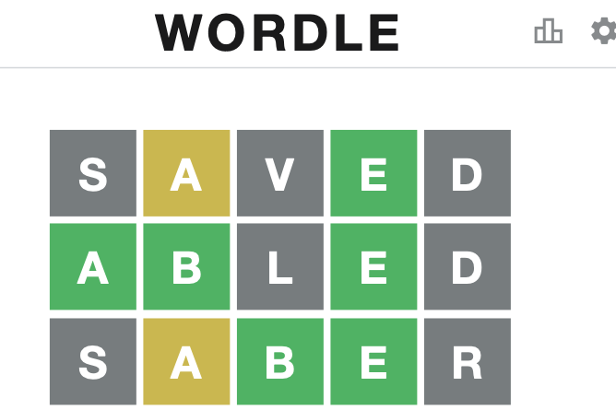
The guessing games
https://www.phillyvoice.com/wordle-strategies-how-to-play/, https://www.looper.com/218228/the-wild-true-story-behind-samuel-l-jacksons-famous-jurassic-park-line/

Slide 6
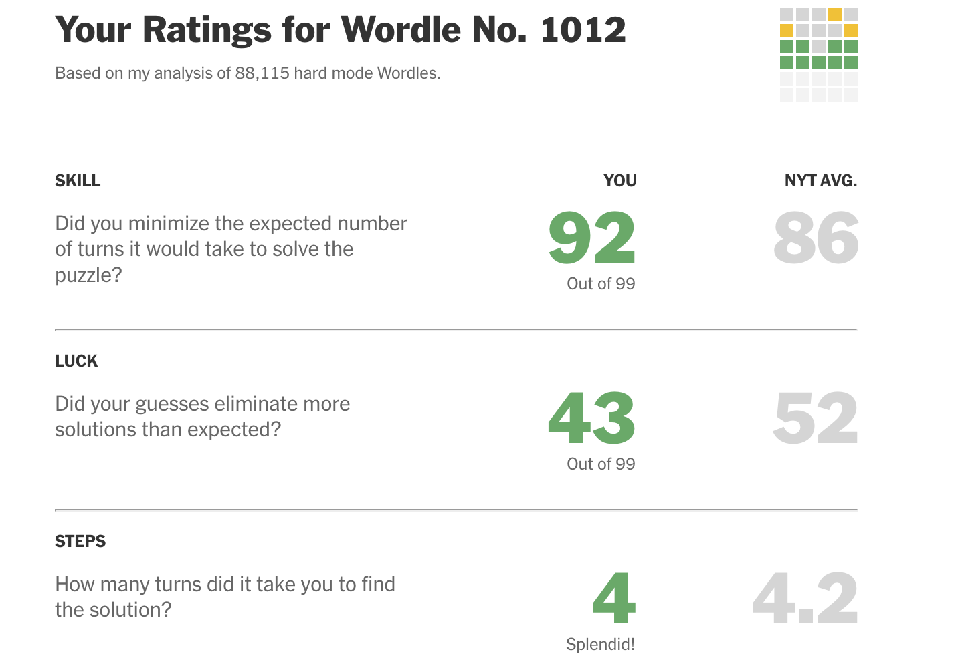
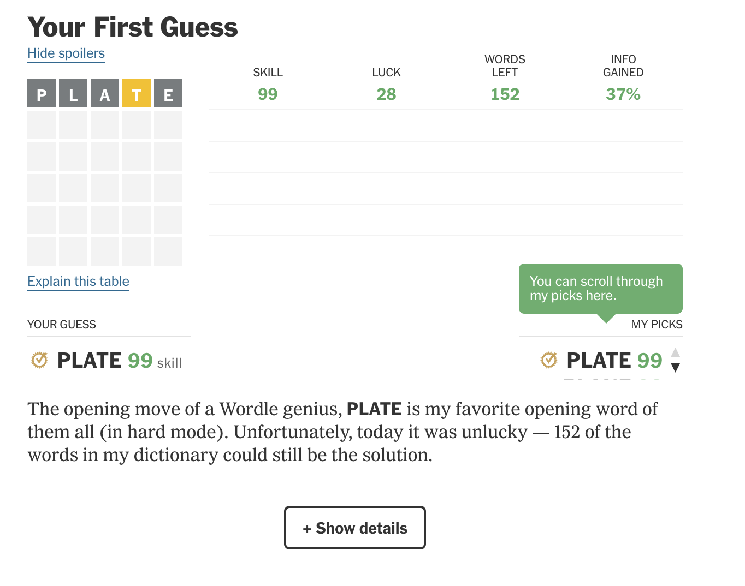
The guessing games
https://www.nytimes.com/interactive/2022/upshot/wordle-bot.html

Slide 7
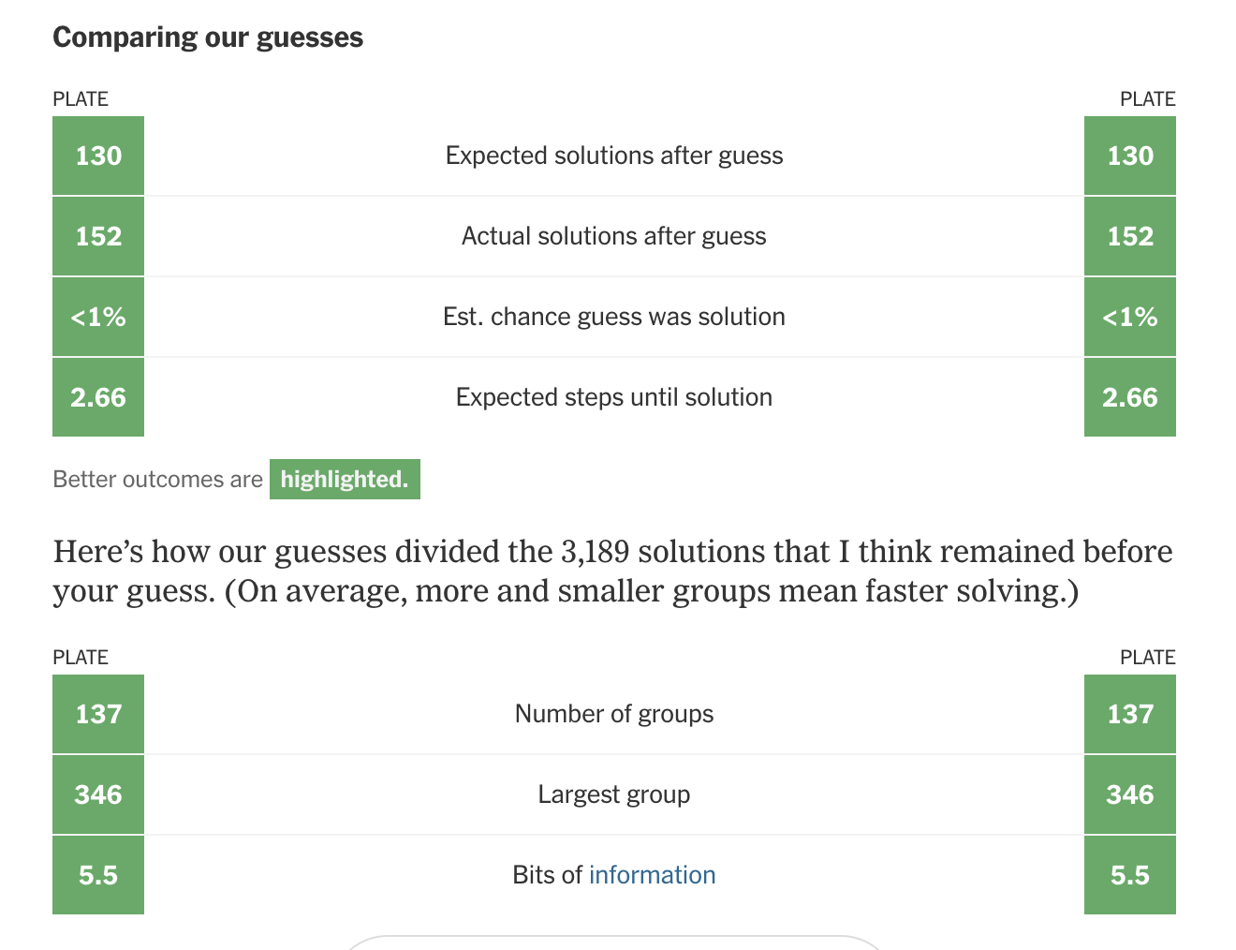
The guessing games
https://www.nytimes.com/interactive/2022/upshot/wordle-bot.html

Slide 8
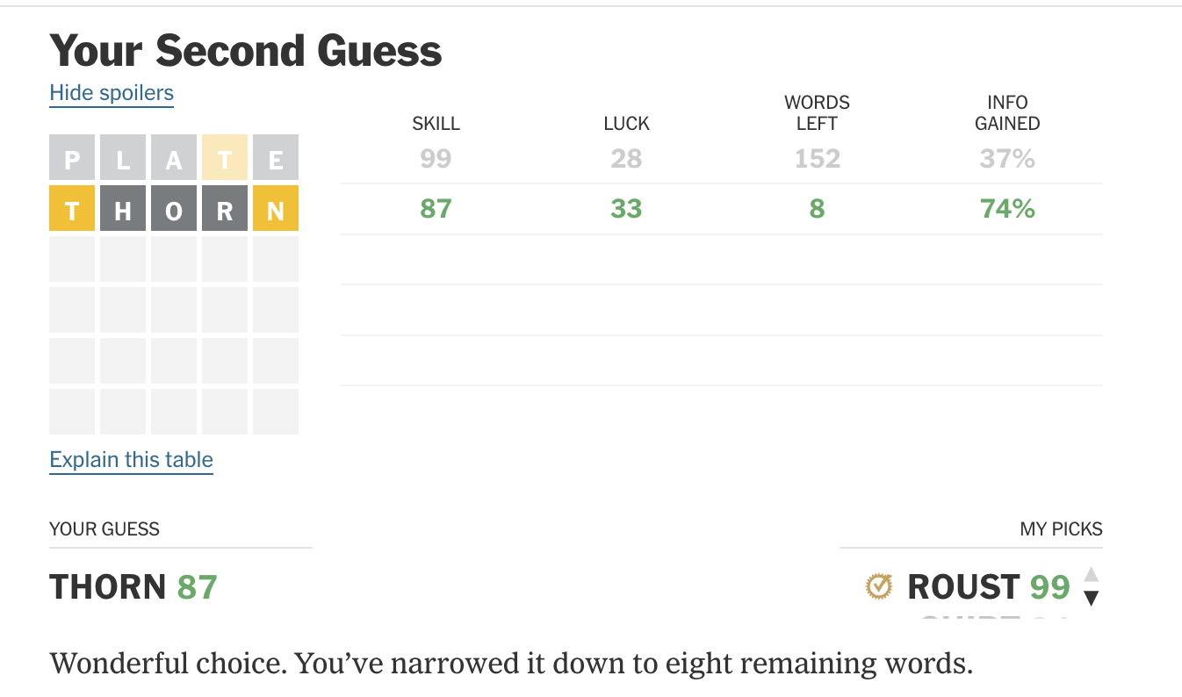
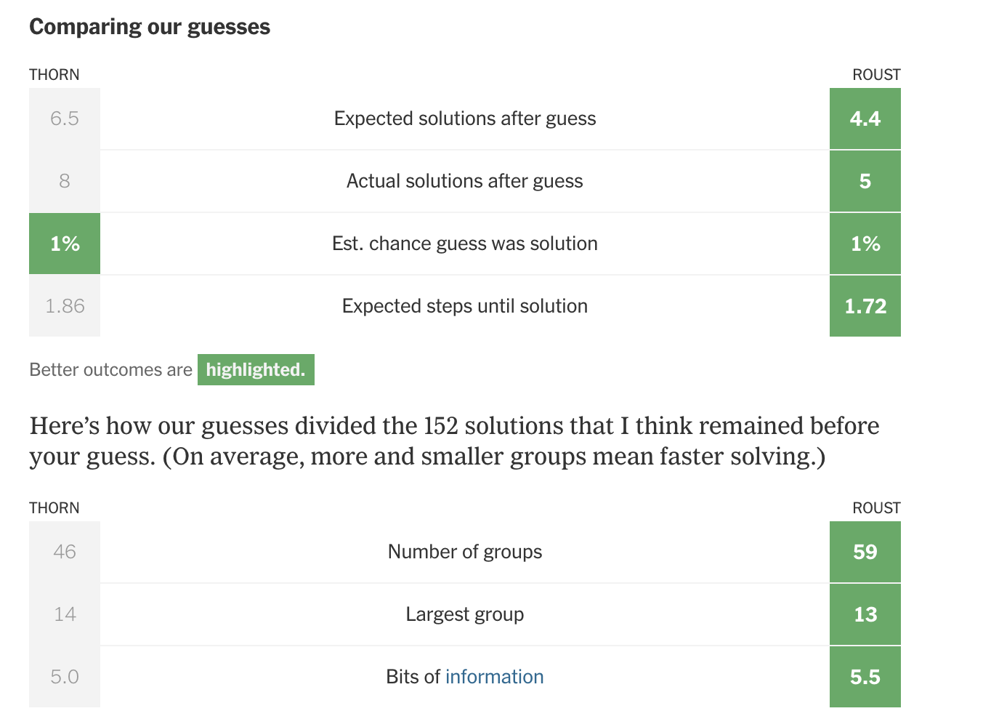
The guessing games
https://www.nytimes.com/interactive/2022/upshot/wordle-bot.html

Slide 9
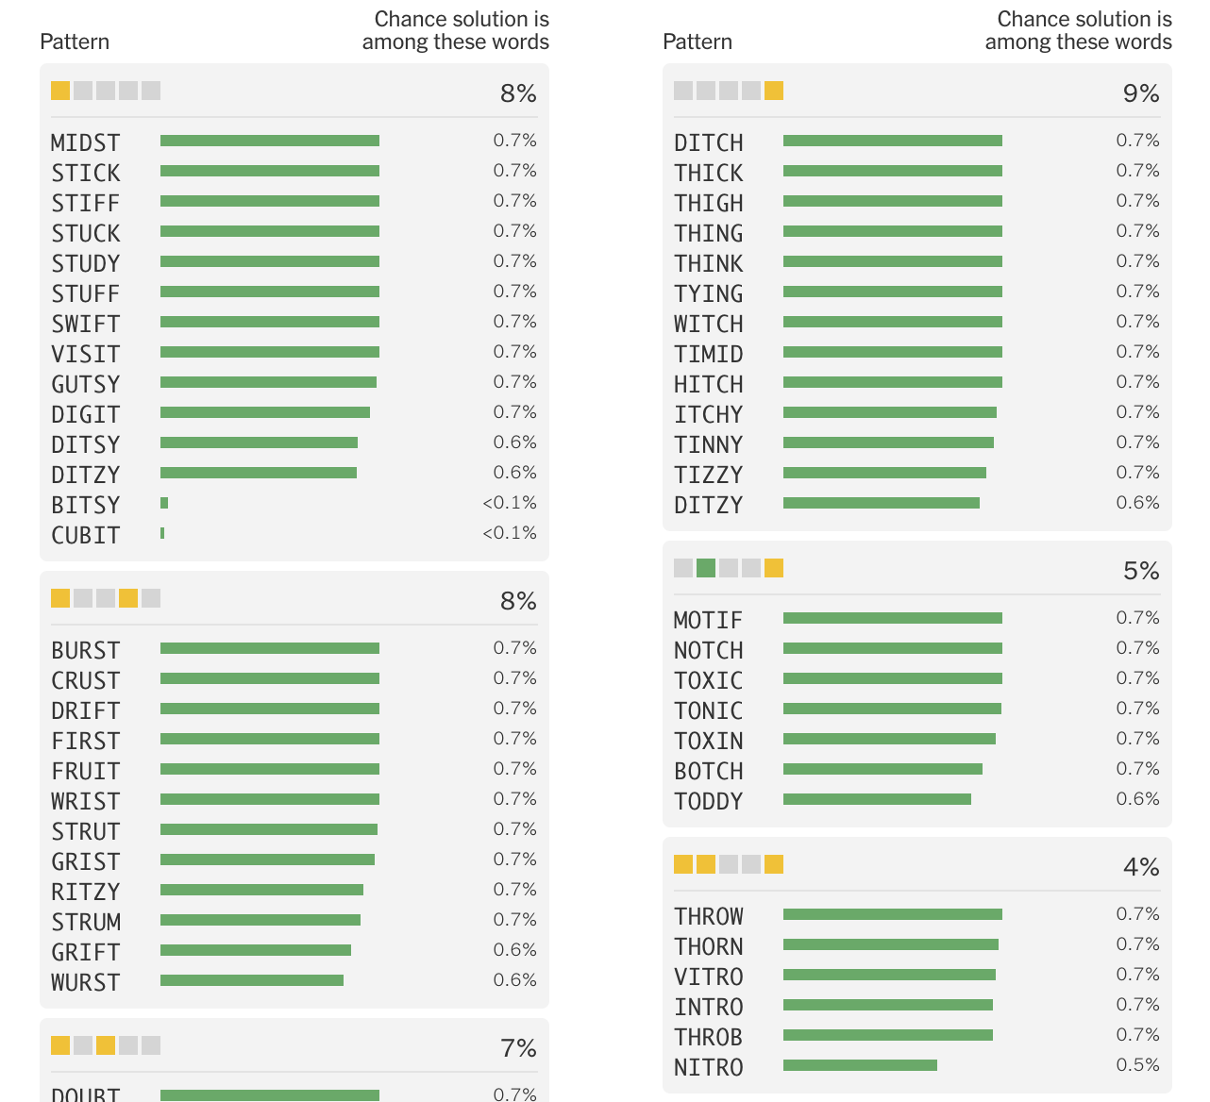
The guessing games
https://www.nytimes.com/interactive/2022/upshot/wordle-bot.html

Slide 10
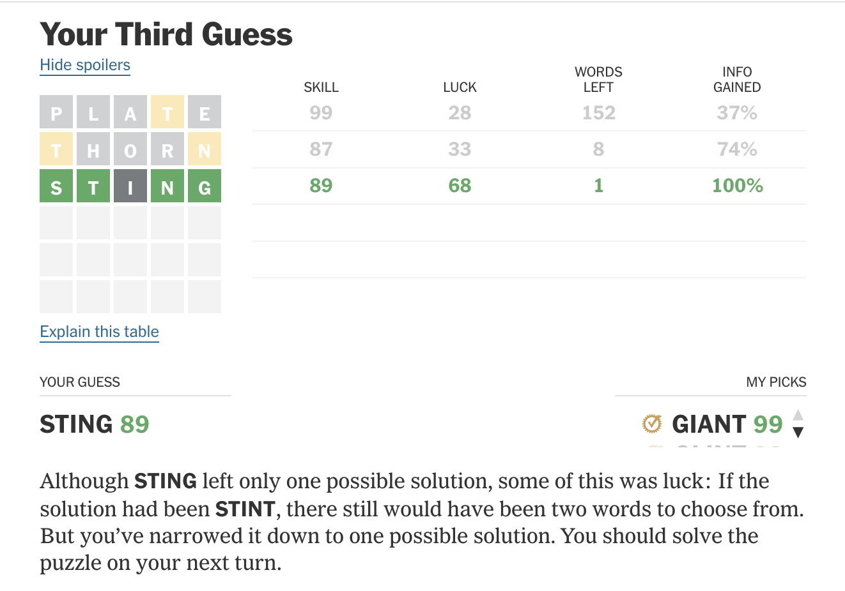
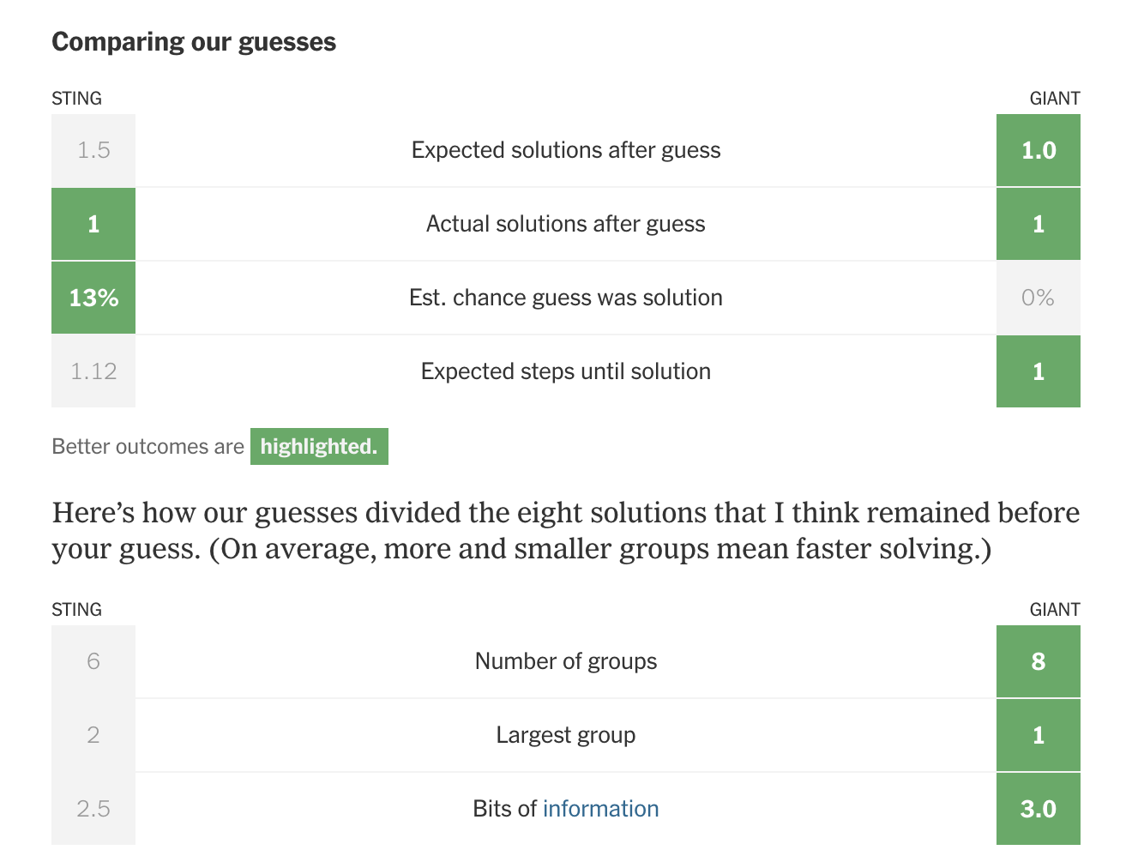
The guessing games
https://www.nytimes.com/interactive/2022/upshot/wordle-bot.html

Slide 11
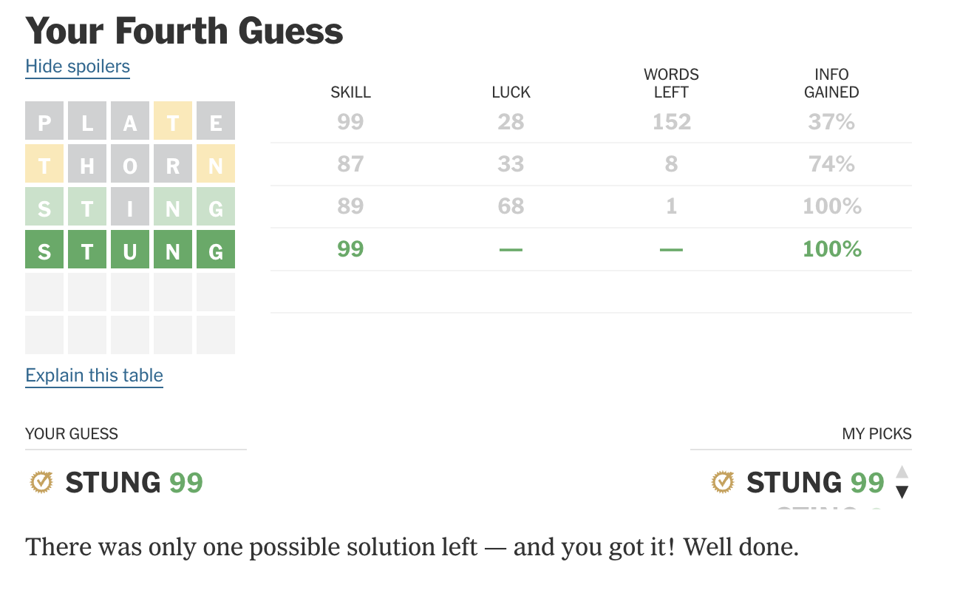
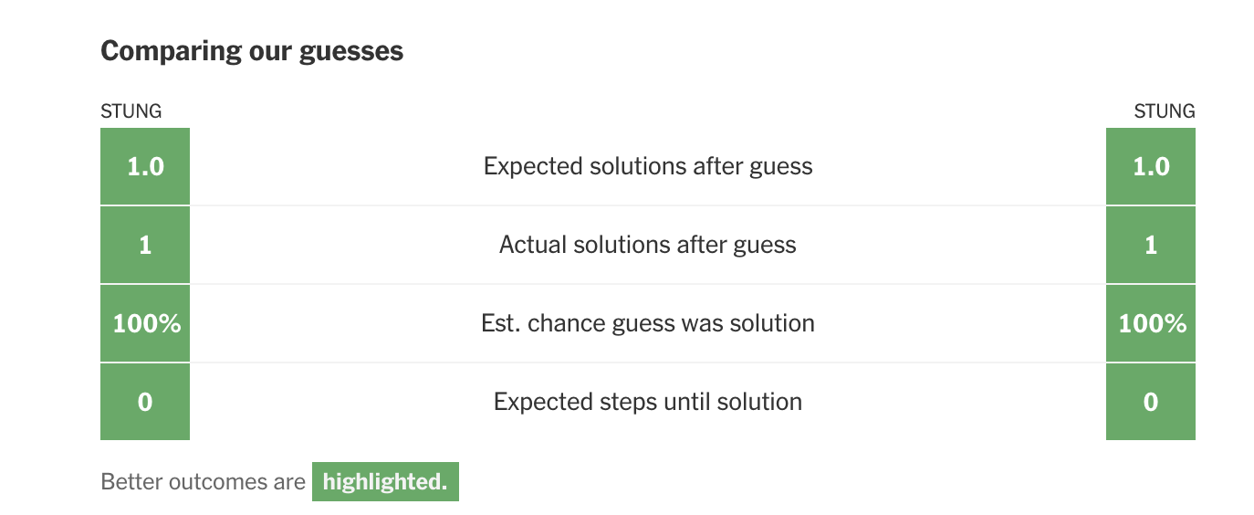
The guessing games
https://www.nytimes.com/interactive/2022/upshot/wordle-bot.html

Slide 12
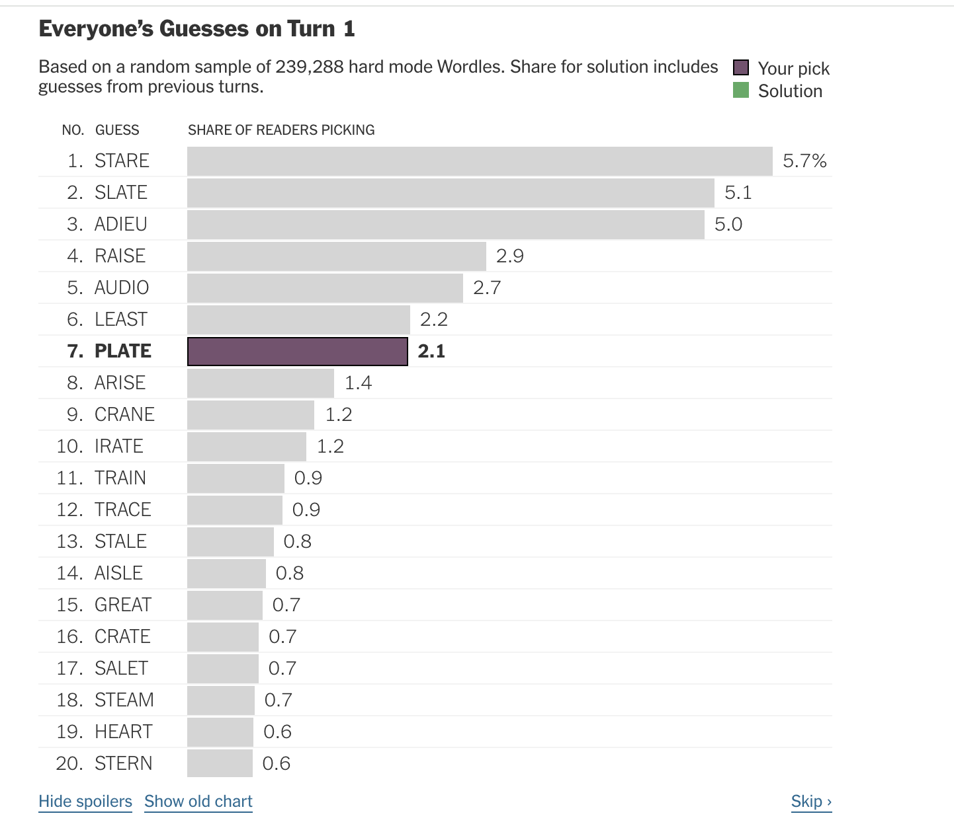
The guessing games
https://www.nytimes.com/interactive/2022/upshot/wordle-bot.html

Slide 13
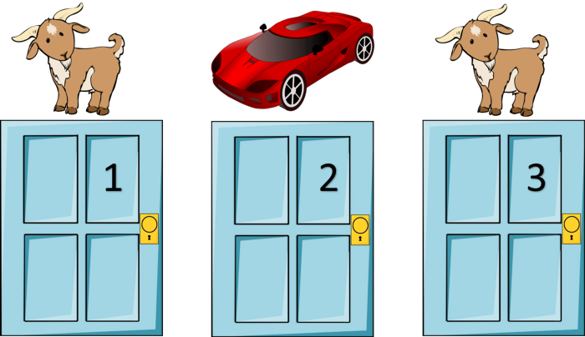
Another (familiar?) game…
https://mathematicalmysteries.org/the-monty-hall-problem/

Slide 14
Let’s make a deal…
1/3
https://mathematicalmysteries.org/the-monty-hall-problem/

Slide 15
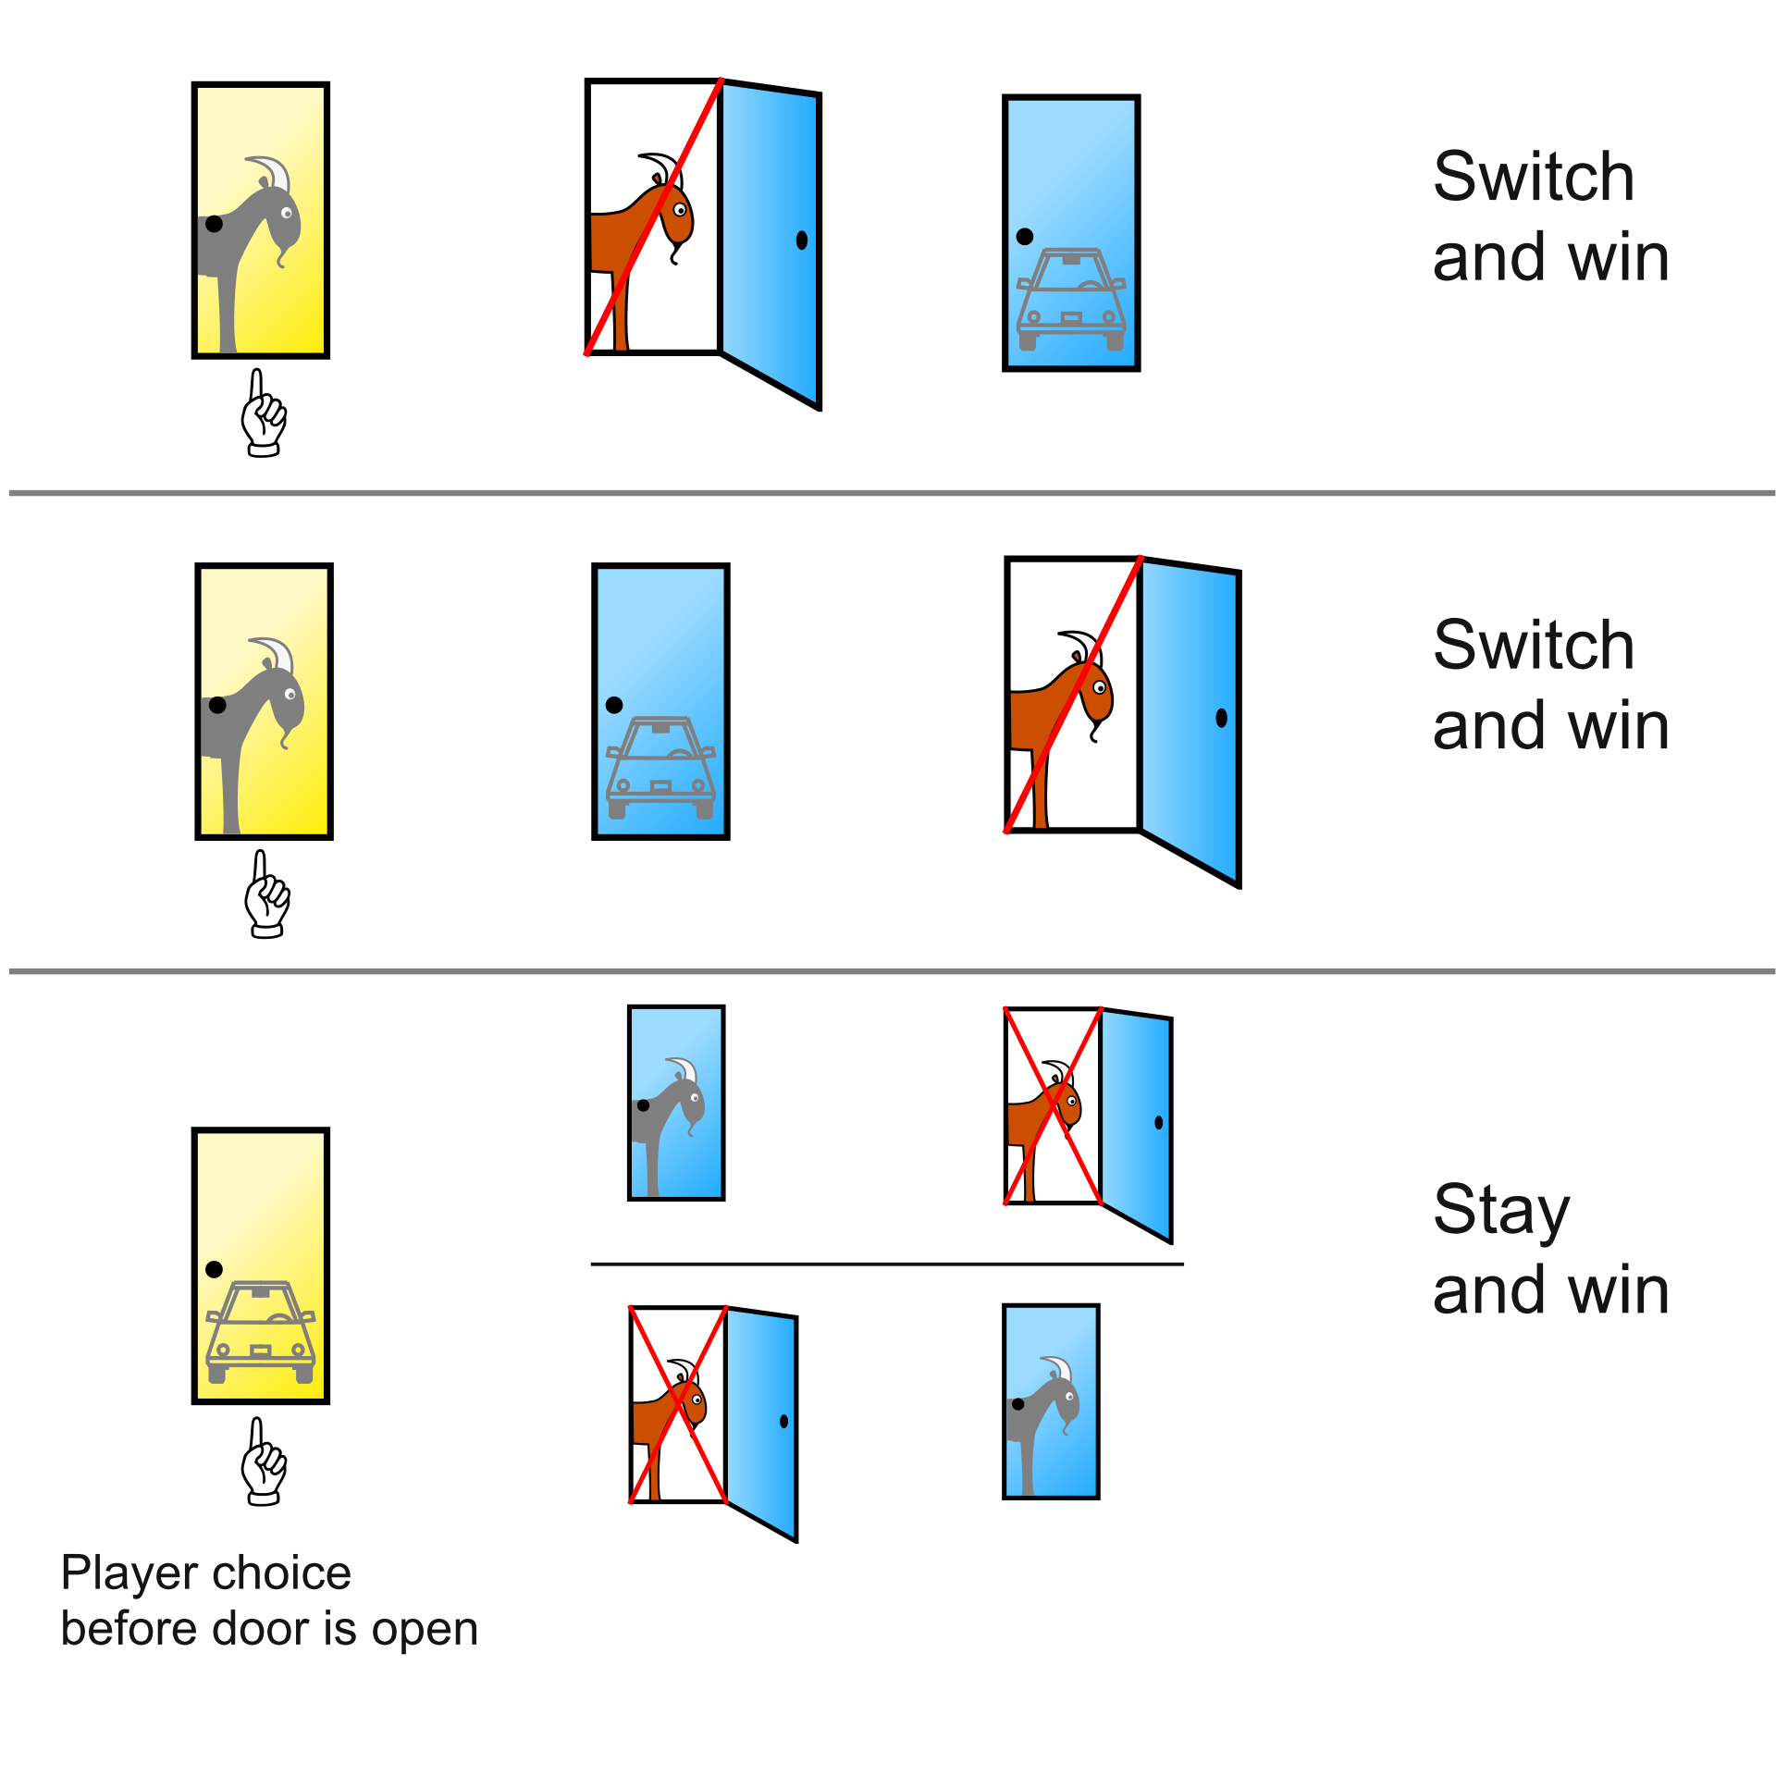
The Bayesian explanation
2/3
1/3
https://en.wikipedia.org/wiki/Monty_Hall_problem#/media/File:Monty_Hall_Problem_-_Standard_probabilities.svg

Slide 16
Information theory
H(X=1–3) = - sum(1-3)[1/3 * log₂(1/3)] = 1.58 bits
H(X=1,2 or X=1,3 or X=2,3) = - sum(1/3 * log₂(1/3) + 2/3 log₂(2/3)] = 0.918 bits
https://en.wikipedia.org/wiki/Monty_Hall_problem#/media/File:Monty_Hall_Problem_-_Standard_probabilities.svg

Slide 17
How do we evaluate information?
Class activity (10 mins): What questions should we ask about data/datasets?
Supplementary Dataset 1
https://www.tampabay.com/resizer/geVYWof5v2nP75k6cGzYunNkMRc=/1400x2500/smart/arc-anglerfish-arc2-prod-tbt.s3.amazonaws.com/public/KAE7GFWHDQI6TBKNIBWI6S7HAY.jpg

Slide 18

How do we evaluate information?
Supplementary Dataset 1
Sample size?
Statistical testing?
QC metrics?
Methods well described?
Technical replicates?
Biological replicates?
Confounding variables?
Data stratification?
Over-fitting / leakage?
Aliasing / artifacts?
Misconduct?
https://images.emojiterra.com/google/android-11/512px/1f914.png

Slide 19
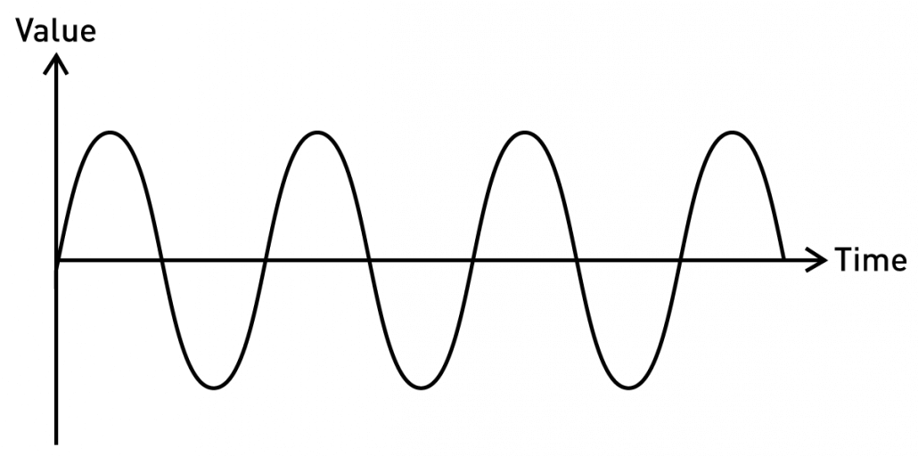
Reminder: types of information
Continuous / Analog
Fully defined. Ie, f(t) == val for any t (in some interval)
Properties such as f, wavelength, amplitude can convey information
https://blog.seeedstudio.com/wp-content/uploads/2020/06/sine-new-1030x512.png

Slide 20
Evaluating continuous information
Goodness of fit / likelihood
RMSE
https://blog.seeedstudio.com/wp-content/uploads/2020/06/sine-new-1030x512.png

Slide 21
Thresholding
Turns continuous information into binary (and discrete)
Establishes decision boundaries
https://blog.seeedstudio.com/wp-content/uploads/2020/06/sine-new-1030x512.png

Slide 22
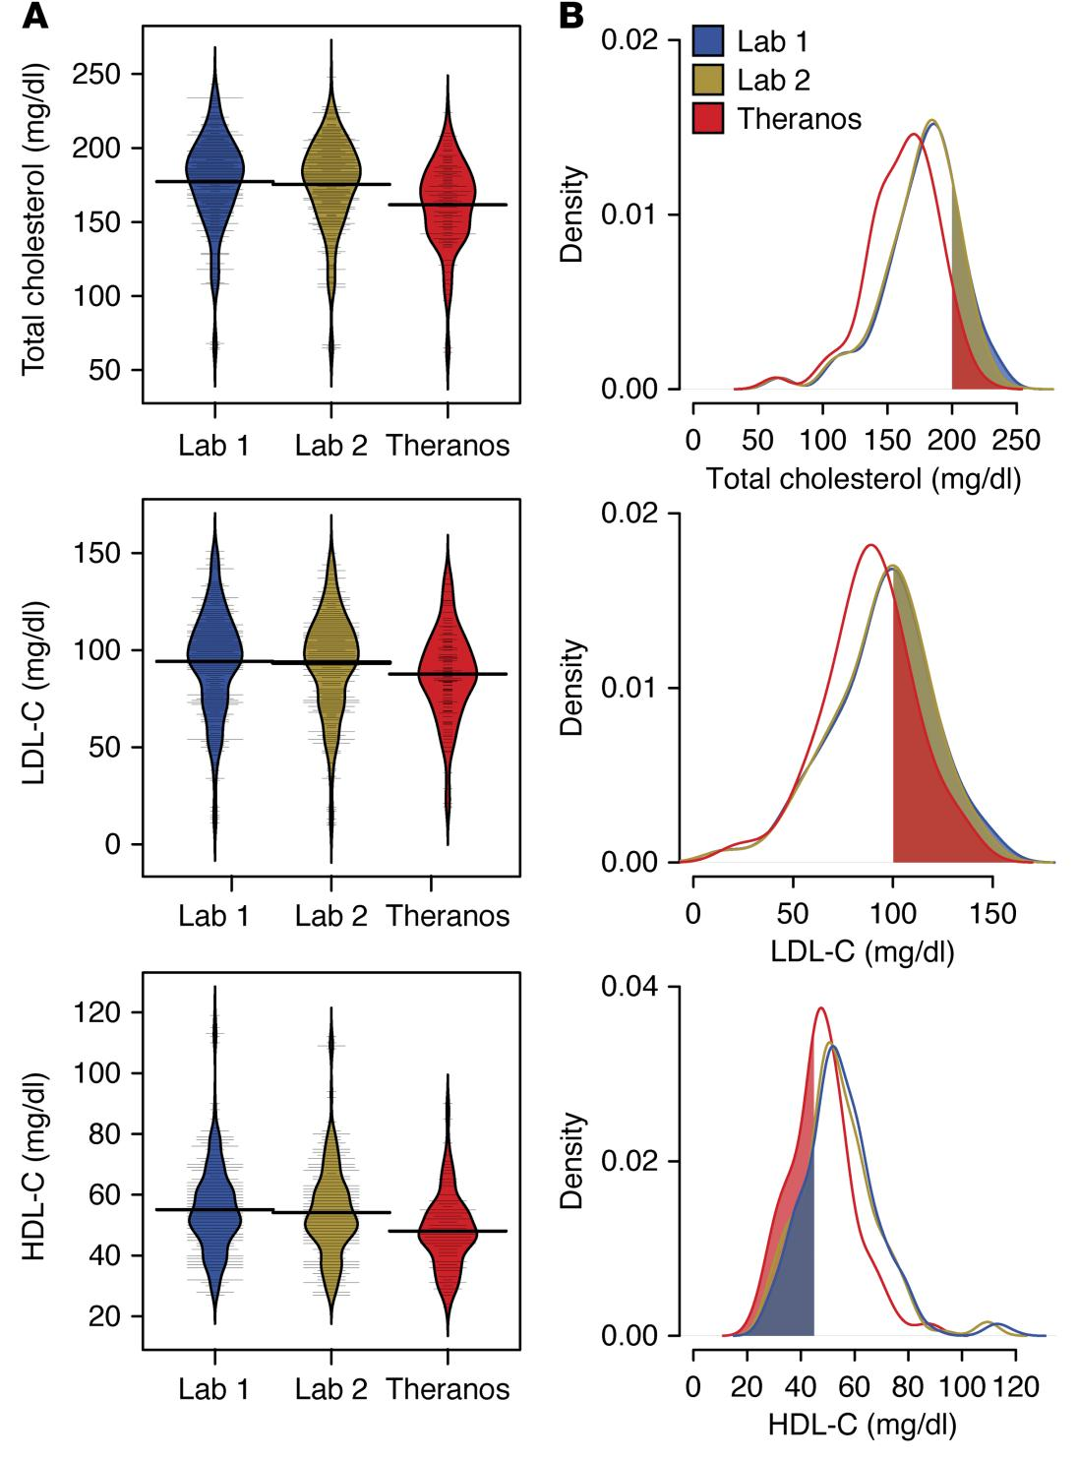
Thresholding in practice
Lab 3
Lab 3
Lab 3
Blood tests from 3 commercial testing sources
Cholesterol, LDL-C, HDL-C have defined normal ranges (upper and lower thresholds)
https://dm5migu4zj3pb.cloudfront.net/manuscripts/86000/86318/large/JCI86318.f4.jpg

Slide 23
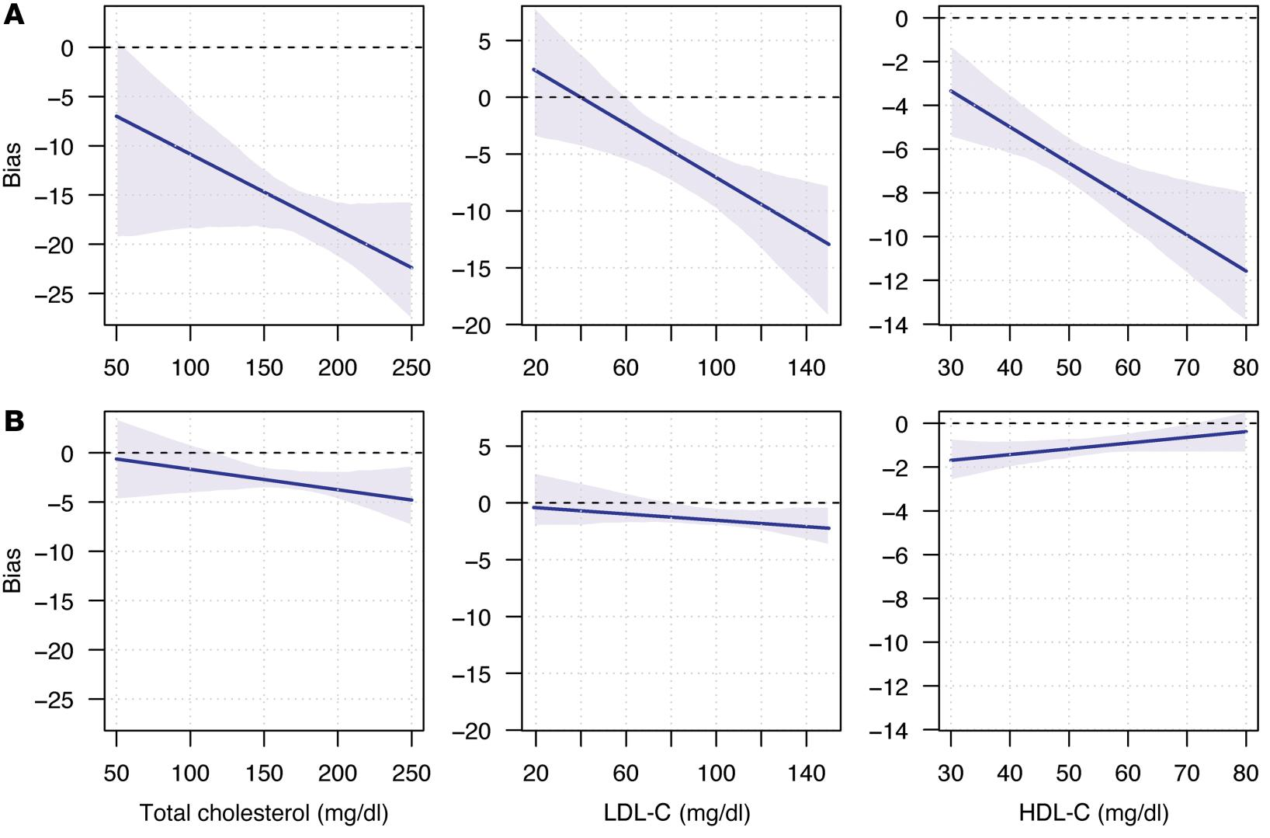
Assessing bias in measurements
I: Lab 3
J: Lab 1
I: Lab 2
J: Lab 1
Bias = discrepancy in using data source I as an estimator for data source J
https://dm5migu4zj3pb.cloudfront.net/manuscripts/86000/86318/large/JCI86318.f5.jpg

Slide 24



A tale of three labs
I: Lab 3
J: Lab 1
I: Lab 2
J: Lab 1
Lab 1
Lab 2
Lab 3
https://1000logos.net/wp-content/uploads/2021/03/Quest-Diagnostics-logo-768x502.png, https://hitconsultant.net/wp-content/uploads/2022/02/Ascension-Selects-Labcorp-to-Manage-Labs-Across-10-States.jpg, https://1000logos.net/wp-content/uploads/2020/11/Theranos-Logo-1024x640.png

Slide 25
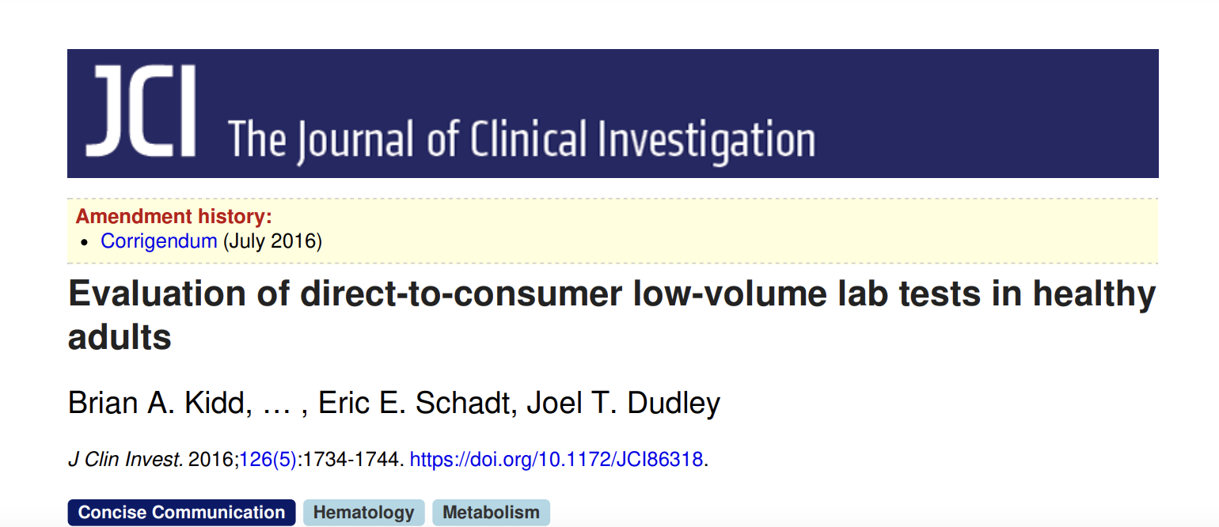
A tale of three labs
The lack of technical replicates in the Theranos data is a notable limitation in our assessment of variability. Given the large intraindividual variability for lab tests from standard clinical services, understanding the variability in low-volume testing is critical for helping physicians and patients interpret test results …
The technical details of the analytical instruments used for the lab tests were unavailable at the time of the study and remained uncertain since its completion, which means that the differences we found could arise from multiple sources…
https://www.jci.org/articles/view/86318/pdf

Slide 26
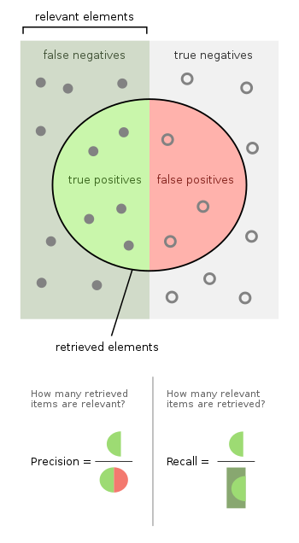
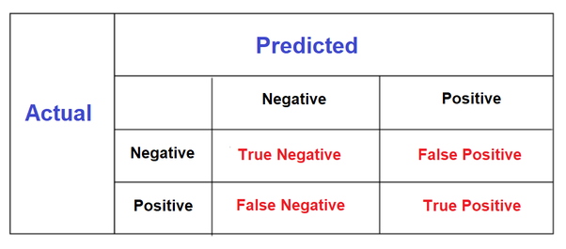
Classifying binary information
“Truth Table”
https://qph.cf2.quoracdn.net/main-qimg-d1f717f321a4ebc8e6d2c1d1cc19f9fc, https://upload.wikimedia.org/wikipedia/commons/thumb/2/26/Precisionrecall.svg/700px-Precisionrecall.svg.png

Slide 27
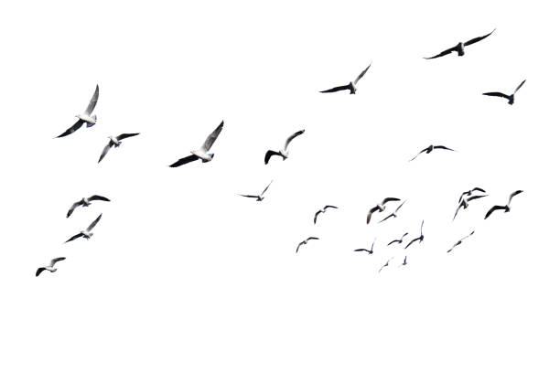
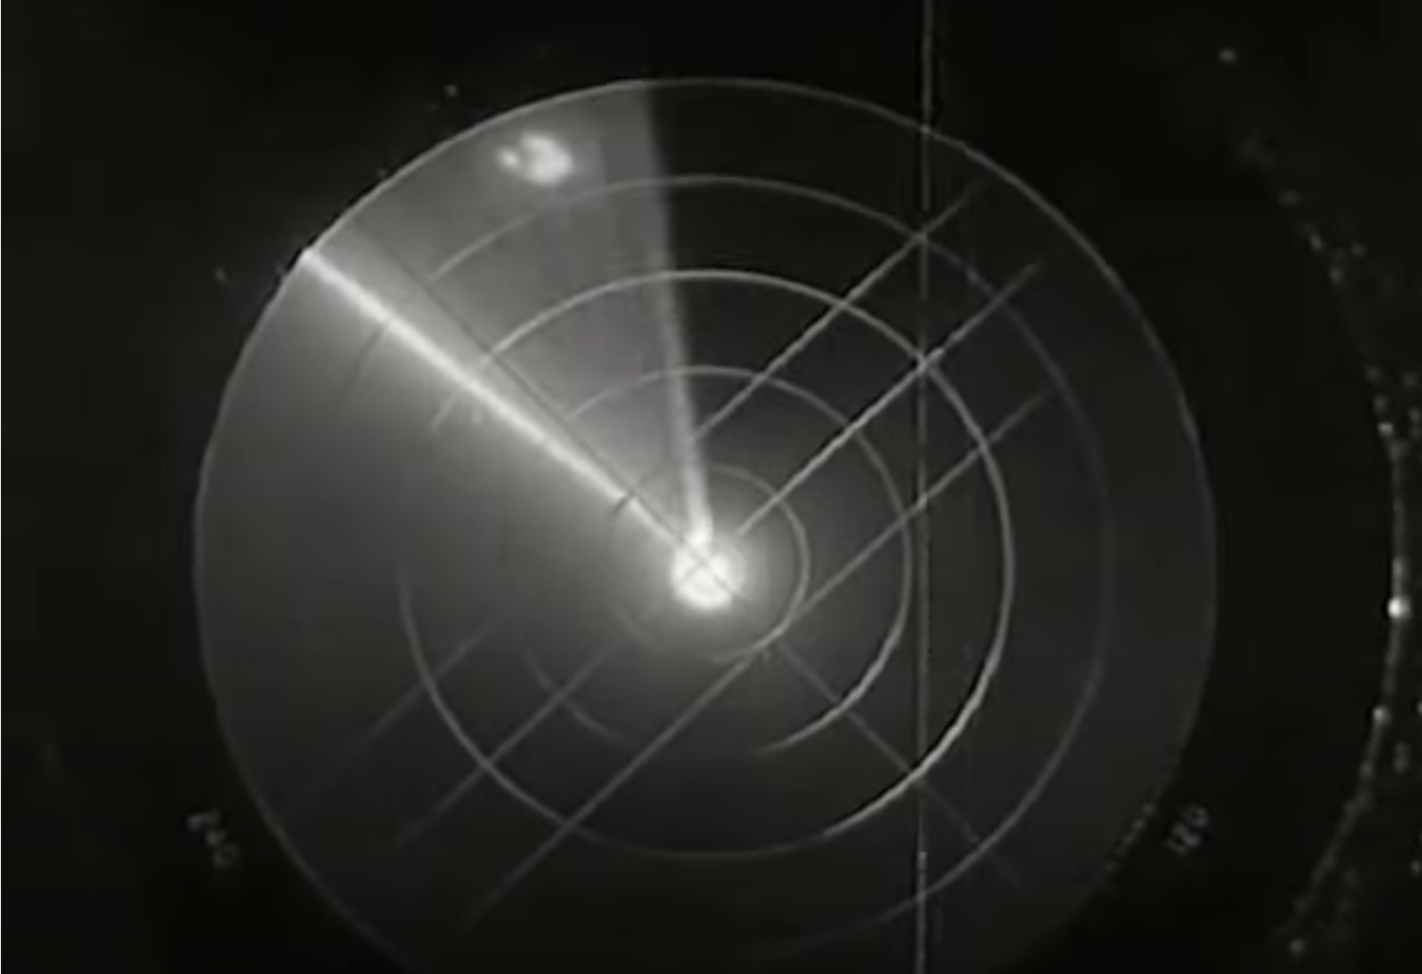
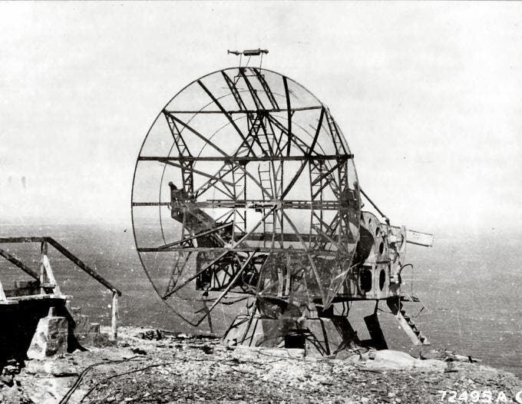
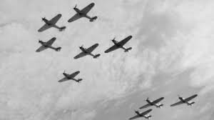
Classifying binary information
Or
https://www.youtube.com/watch?v=73pU2lRHefQ, https://worldwarwings.com/the-idiotic-wwi-aerial-formation-used-by-the-allies-in-the-second-world-war, https://www.zmescience.com/science/physics/microwave-oven-from-ww2/, irgas.com

Slide 28
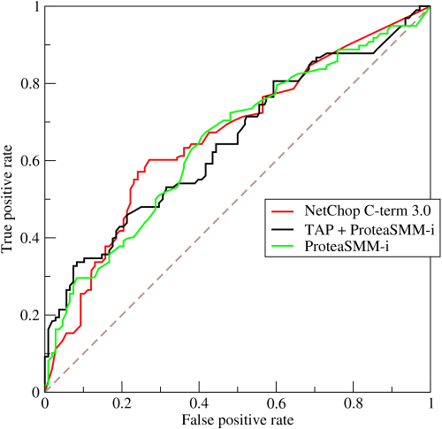
Receiver Operator Characteristic Curves
TPR = TP / (TP + FN)
FPR = FP / (FP + TN)
https://upload.wikimedia.org/wikipedia/commons/6/6b/Roccurves.png

Slide 29
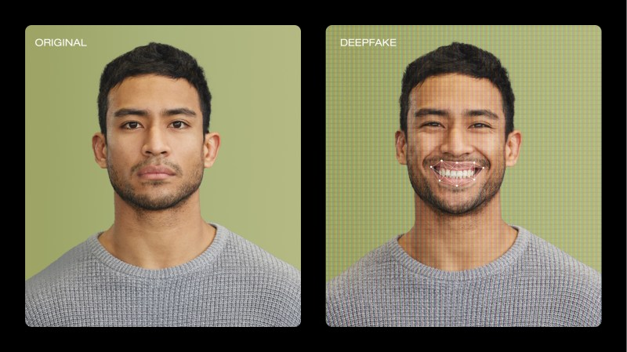
Game time!
Two teams. Phones/computers away
Give each image a “fake score” of 0 (not likely to be a deep fake) to 5 (super likely to be a deep fake)
https://vimeo.com/blog/post/video-deepfakes/

Slide 30
HW: ROC out your deepfake results
Generate your (FPR, TPR) for fake scores 1–5
Plot a curve and measure (or estimate) AUC
TPR = TP / (TP + FN)
FPR = FP / (FP + TN)
https://upload.wikimedia.org/wikipedia/commons/6/6b/Roccurves.png

